Slide 1
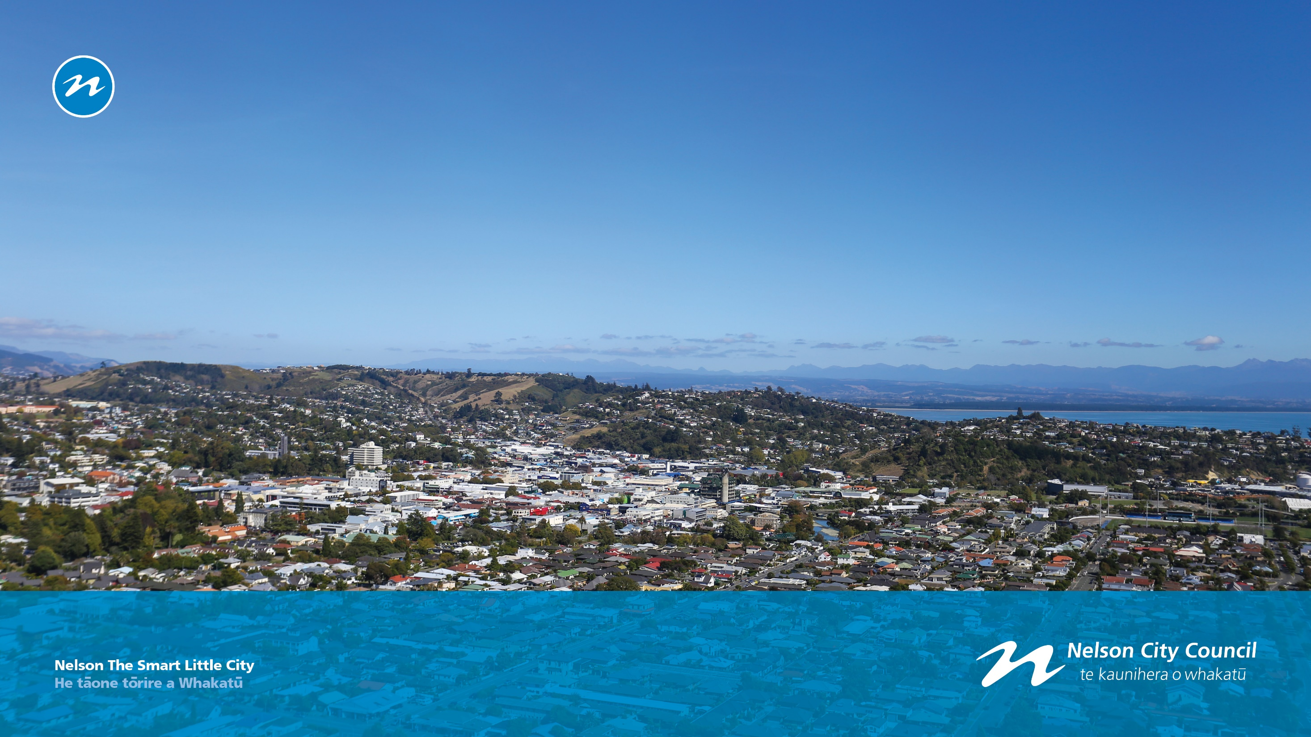
Visioning the Relocatable Autonomous Projection Structure

Slide 2
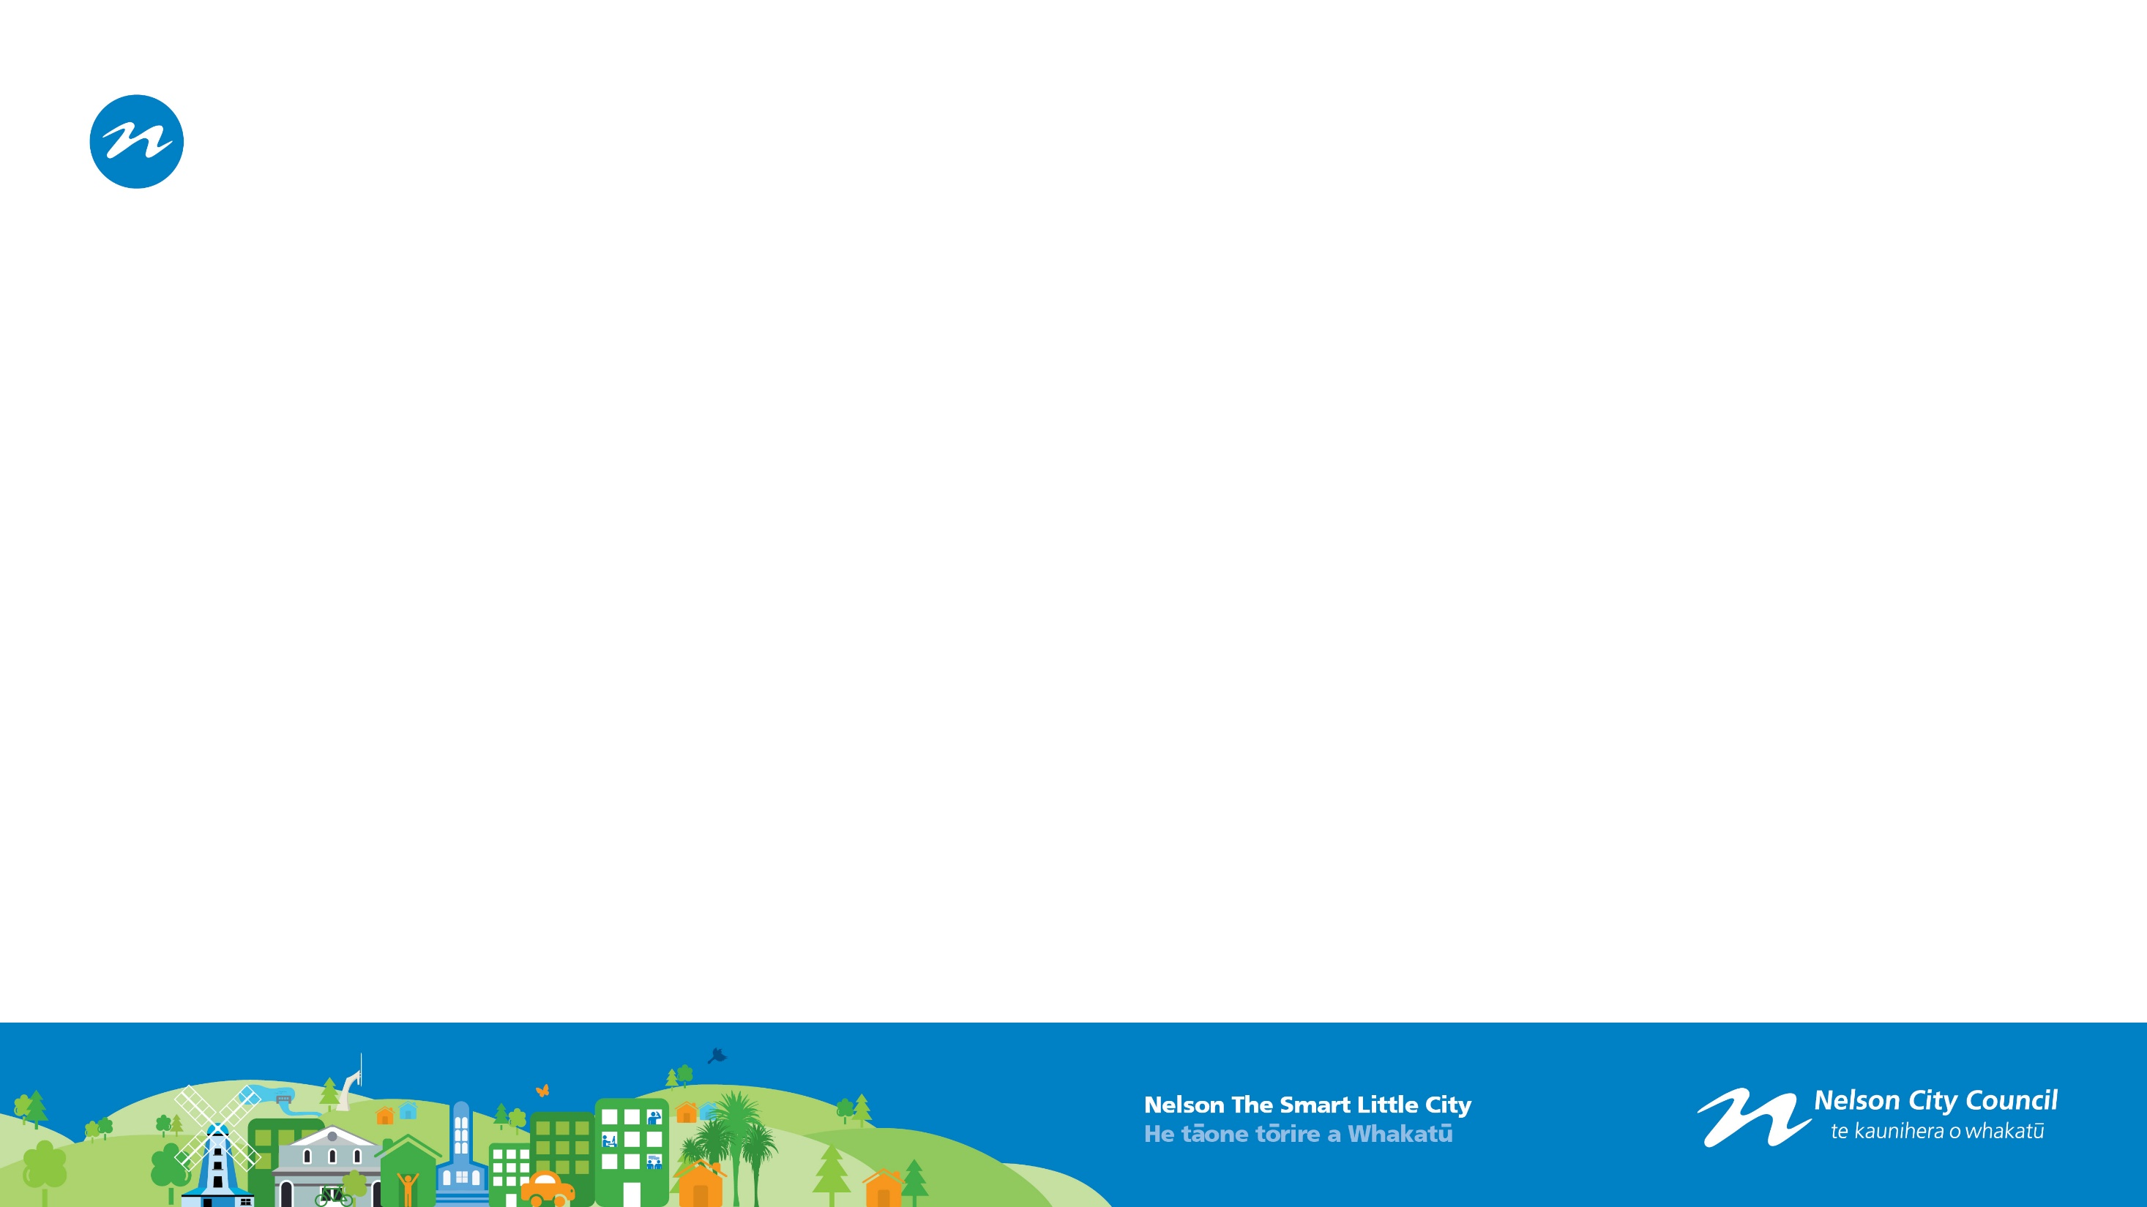
Light Art Projection-Background and Case Studies
Here follows a selection of six case studies from the thirty plus light art projections that have occurred over the last three years, using Councils projection assets.
Partners were given free access to equipment.
Partners were sometimes supported with a grant to pay for projection art/technician time.
All were only affordable for a single night but could have been more widely enjoyed if run for longer.

Slide 3
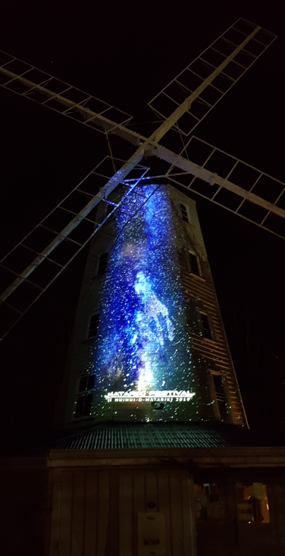
Matariki 2019
Projection on Founders Park Windmill.
15 minute repeated loop with soundtrack.
Cultural oversight of imagery provided via Te Kāhui Whiria.
Single night show.

Slide 4
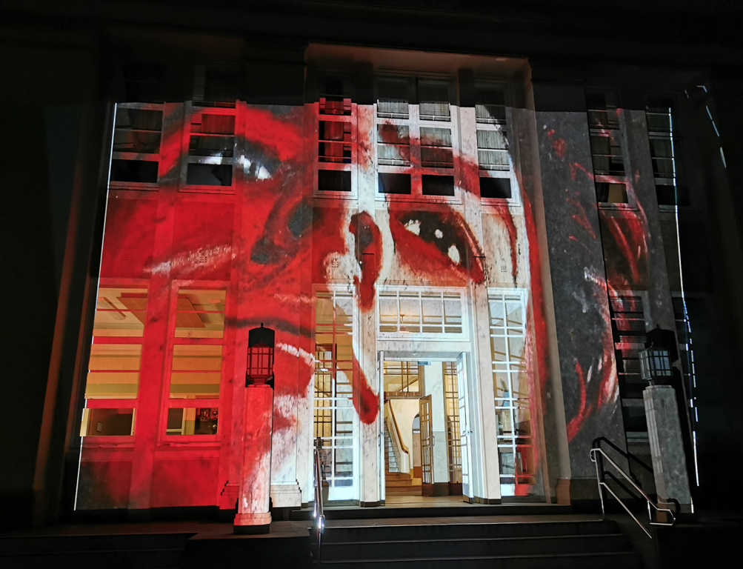
Nelson Boys College Artwork Projections
Students art work projected on Nelson Boys College.
Collaboration with art department.
Over 20 artists featured in large format.
Single night show.

Slide 5
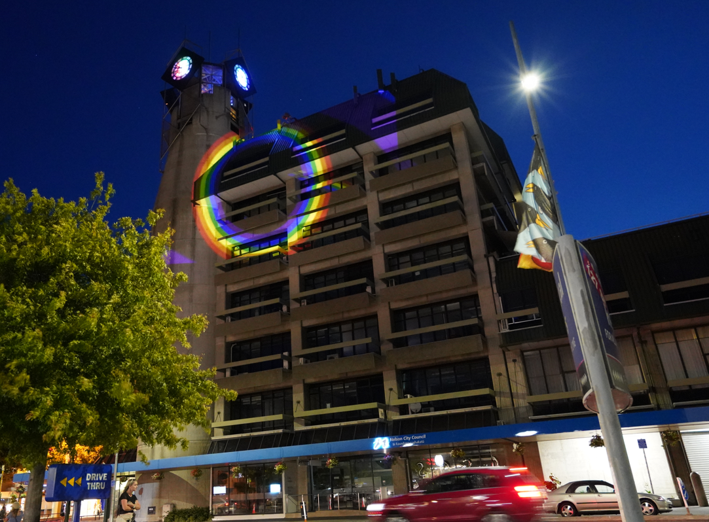
Safe Space Alliance Projections
Partnership with Suter Art Gallery to support an exhibition on LGBTQI+ issues.
Launching of Safe Space Alliance in NZ/Nelson.
Large rainbow projections on buildings of note- NCC, Police, Hospital as support for the LGBTQI community.
Single night show at each building.

Slide 6
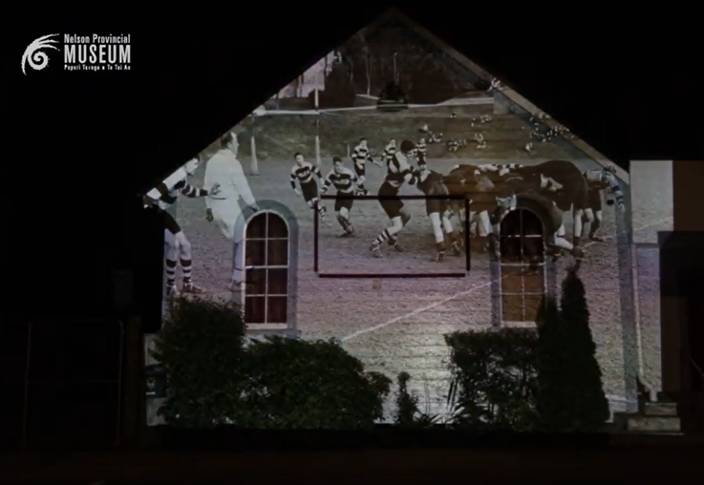
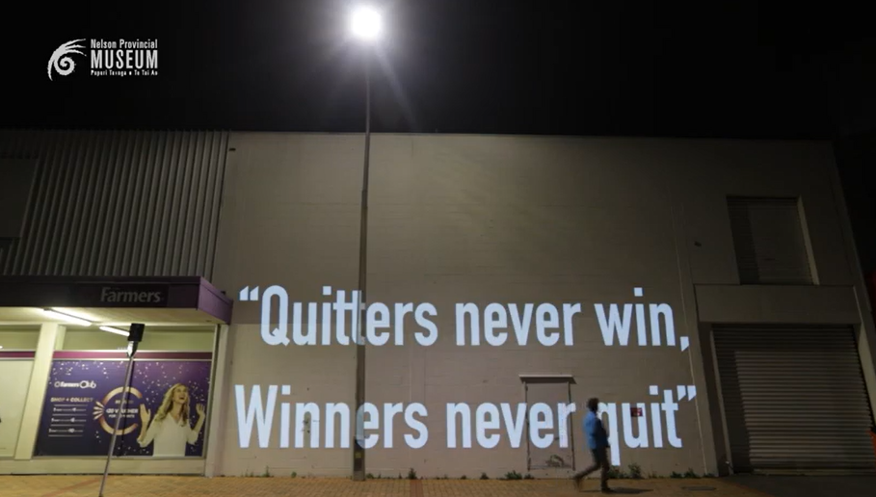
Rugby 150 Projections
Partnership with Provincial Museum to commemorate the 150th anniversary on NZs first rugby game.
COVID 19 resilience response in Level 3.
Single night show.
https://www.youtube.com/watch?v=KkEAXJRcwtM

Slide 7
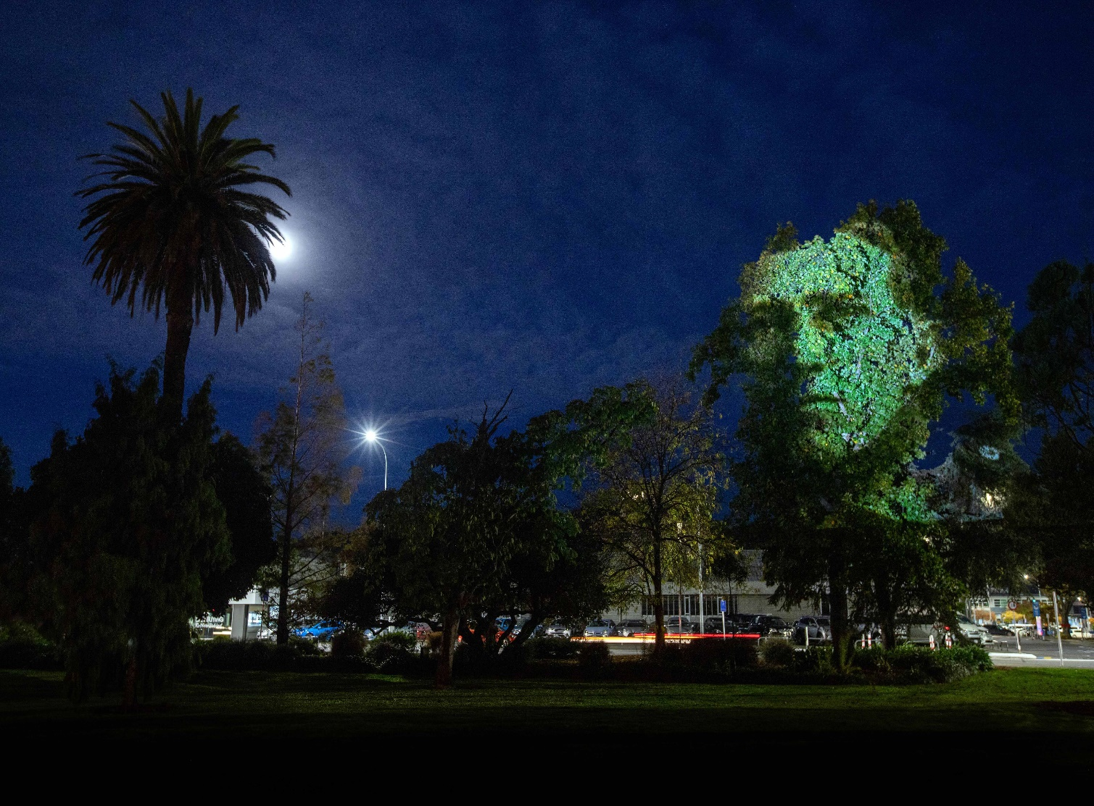
ANZAC 2021 Projections
COVID 19 response as a backup for potentially canceled Dawn Service.
Trees in ANZAC Park used.
RSA provided partner funding.
Single night show.

Slide 8
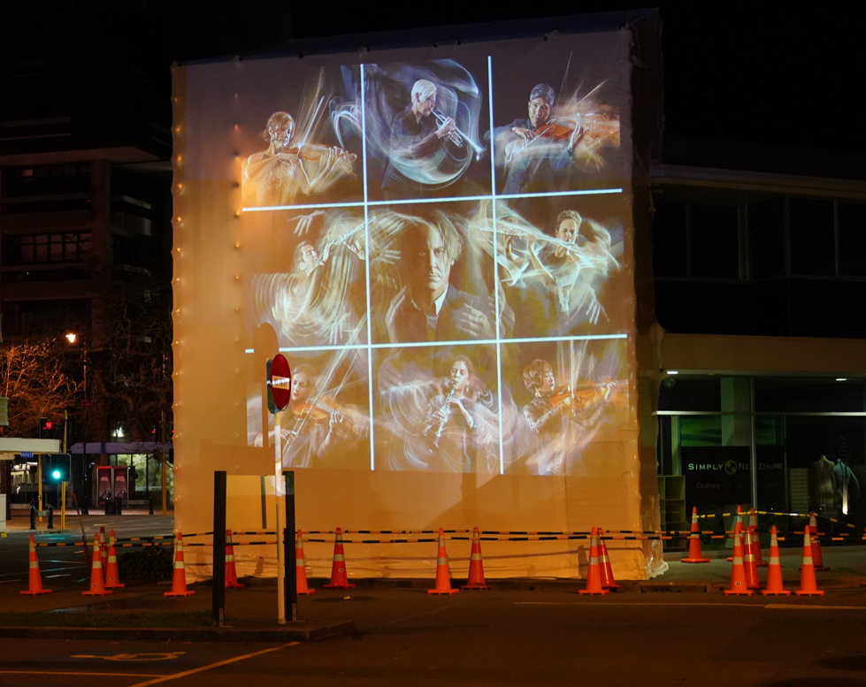
NZ Photography Conference Projections
Partnership with the annual NZ Photography Conference.
Shared photo images with the non delegate community.
Used wrapped building under repair.
Single night show.

Slide 9
Expansion of Light Art Projection Projects- Identified Needs from Community Partners:
Wanting longer projection shows. 6-10 nights rather than 1 night.
Wanting all rigging and consenting issues to be dealt with. Requesting a one stop shop package.
Wanting longer show durations that can justify more expenditure on show animation, raising the quality/impact of shows.
Expected increased in demand for shows. Expectation of an increase in demand to 20-30 week-long shows a year or light shows running for approximately 200 night a year.

Slide 10
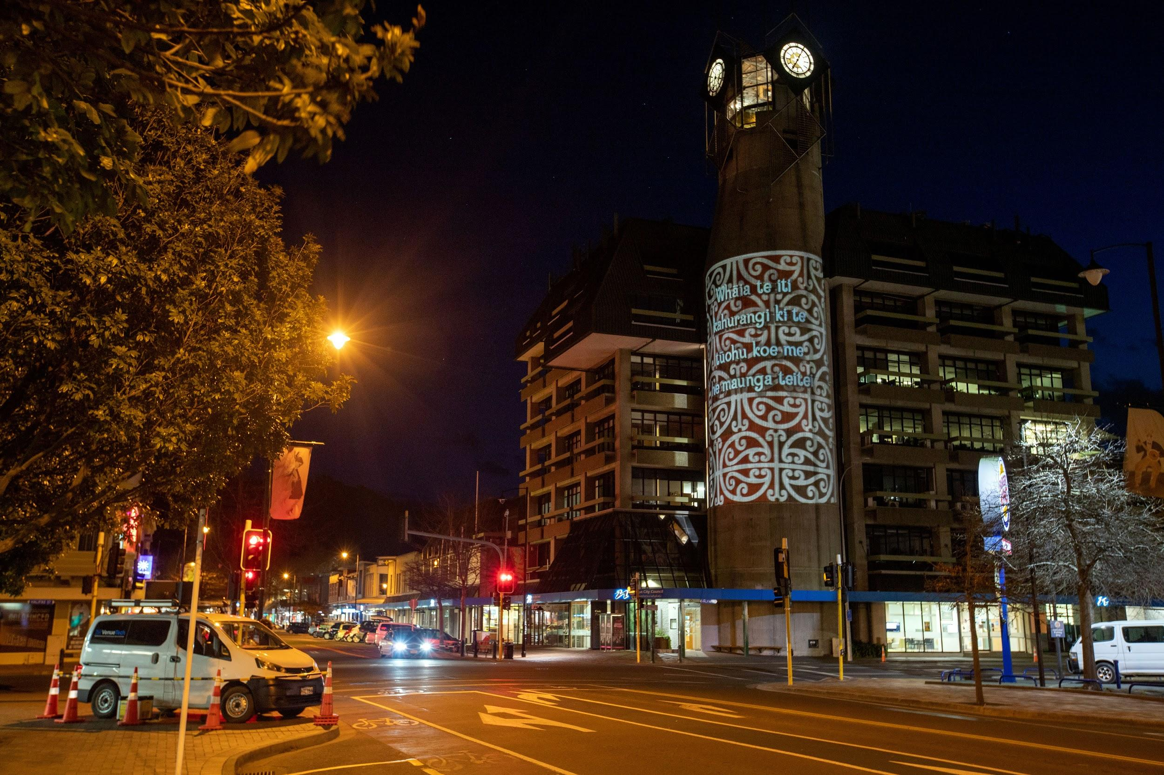
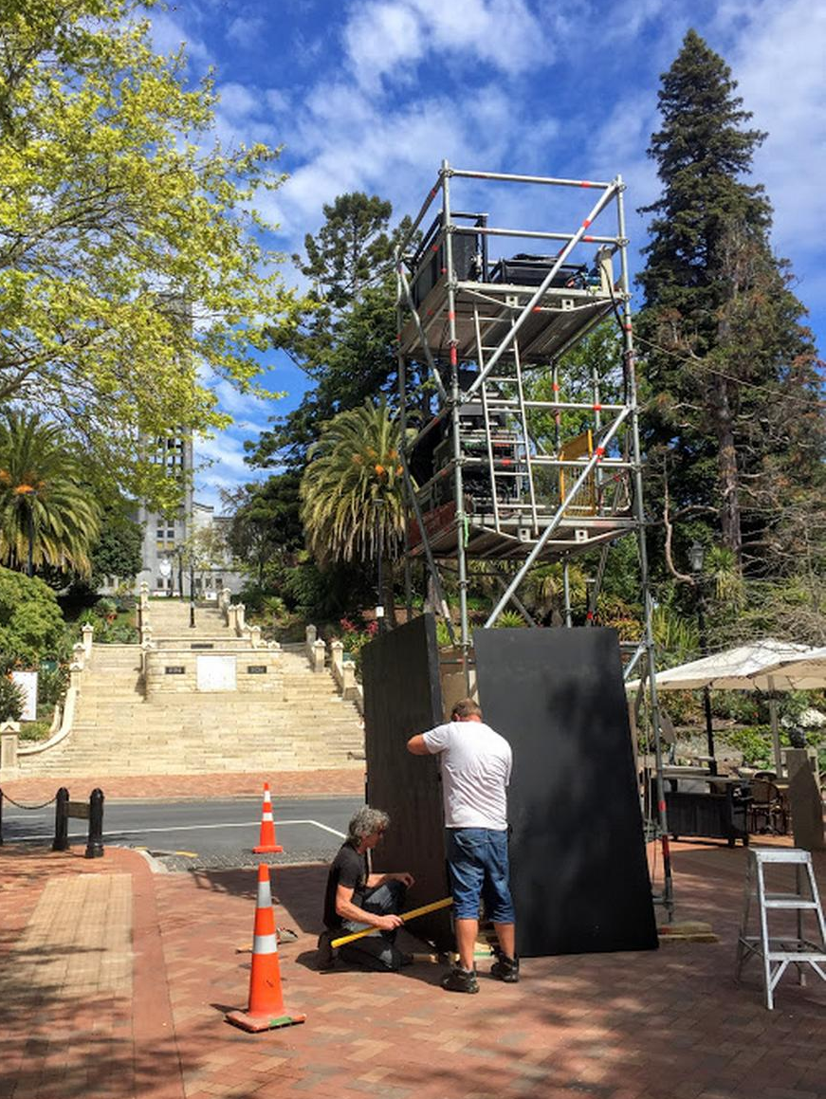
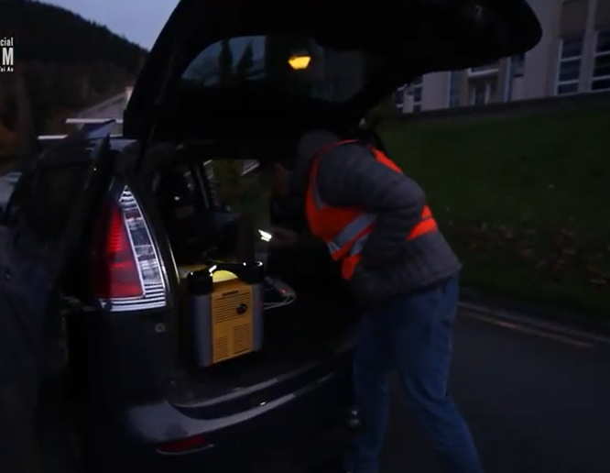
Barriers to Expansion- Downsides to the Current Technical/Rigging Systems:
Out of cars/vehicles- No height advantage.
On buildings in VIZBOX units- Hard to secure.
On purpose-built scaffolds- Expensive to set up and secure so prohibitively costly to use for unmonitored multi night shows.

Slide 11
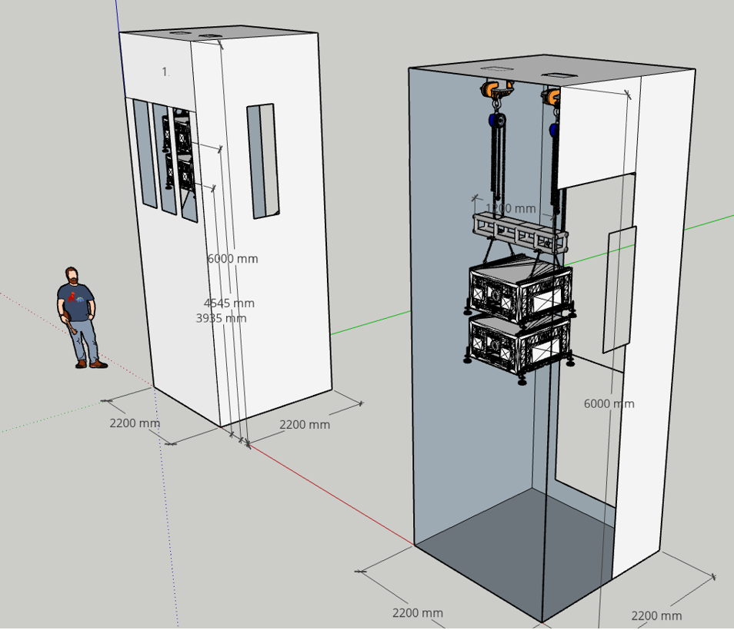
Next Steps-
Release RAPS Project Arts Brief to design/artist/engineering community- /Nov 22.
Select a supplier to construct the RAPS and obtain Building Act compliance-March 2023.
RAPS constructed and first used. -Ready for Te Ramaroa in July 2023.

